Slide 1

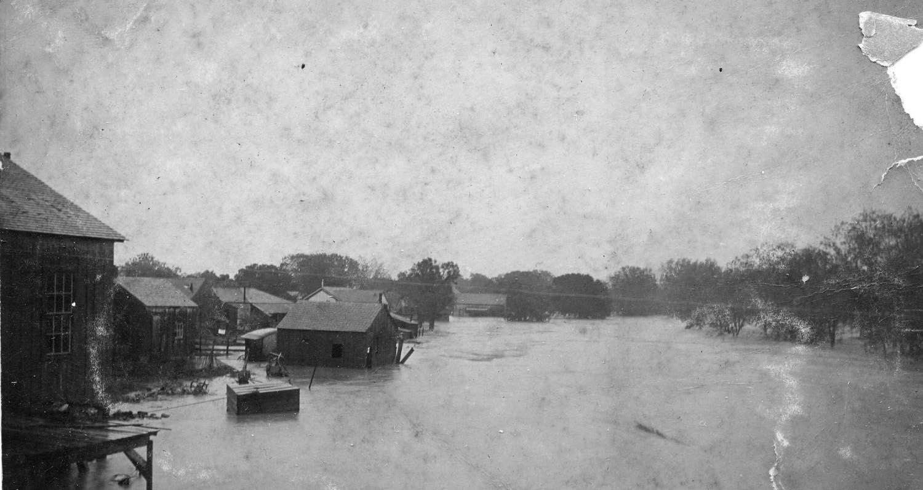
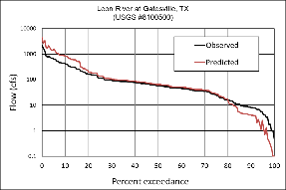



A multipurpose toolset for reducing flood risk and understanding future water supplies in the
Leon River and Cowhouse Creek Watersheds
Nolan Creek Flood in Belton – 1913
Photo courtesy of the Bell County Museum

Slide 2






The Texas General Land Office provided guidance, oversight, and funding for this study.
Program Partners

Slide 3
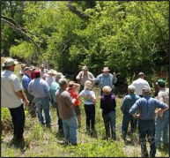
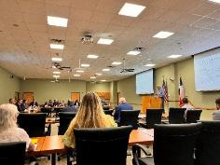

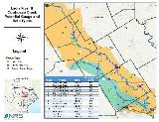
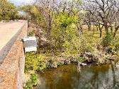
Program goals
Engage and involve local stakeholders
Program website
Develop hydrologic-hydraulic flood flow models - AgriLife
Develop groundwater flow and storage models - RRGPE
Develop a multi-component flood-risk management plan (assessment, coordination, planning, and education) - ACF
Develop a demonstration flood monitoring sensor network – AgriLife, ACF
Develop local stakeholder and public preferences for Texas flood policy and actions - ISTPP

Slide 4
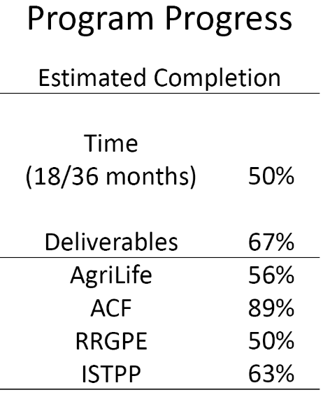
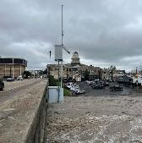

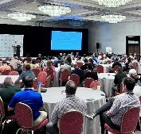
Deliverable Description
1
3
4
8
9
12
14
16
17
18
19
20
21
22
23
25
26
27
Initial project meeting report Quarterly reports (10)
2
Initial Surface Flow Models (SFMs) code and input data sets SFM performance report
SFMs application report
Low-cost stream sensor network and operation report Final SFMs, data sets, and applications summary report
5
6
7
Initial groundwater flow models (GFM) and input data sets GFM performance report
GFM application report
Final GFM, data sets, and applications summary report
10
11
Proceedings of preliminary meetings Proceedings of secondary meetings Summary report of public survey results Final community assessment report
Summary report and geo-referenced dataset of historic events Summary report of community structure
Summary report and geo-referenced geologic and hydrologic data sets
Final watershed assessment report
Summary report of local flood need assessments and solutions Flood Emergency Warning System Plan w/ Standard Operating Procedures
Summary report of stream monitoring equipment and signage installation
Flood hazard and awareness educational materials for distribution Final Comprehensive Flood Mitigation Report
13
15
24
Preliminary interview discussion guide and sample pool. Indepth interview summary report
Preliminary stakeholder and community workshop materials Stakeholder and community workshop summary report Public survey summary report
Final comprehensive policy project report
28
29
30

Slide 5


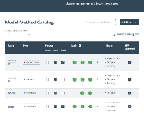
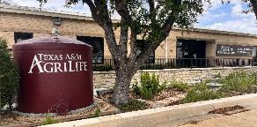
Program Modeling Products
Completed public domain models (i.e., documentation, code, and supporting datasets) will be stored in the GLO’s online Texas Disaster Information System (TDIS) repository
AgriLife will host the live models in Temple to provide
  Continued development, refinement, and support
  Real-time outputs for public and private users

Slide 6

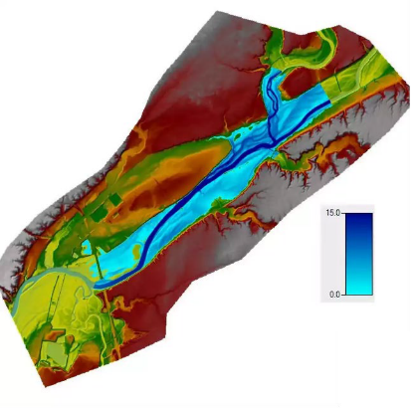

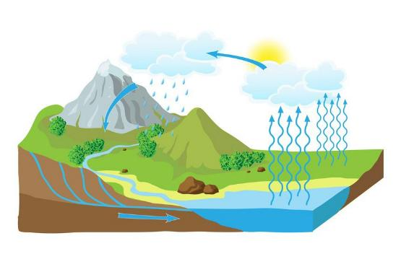

Hydrological Modeling
Hydraulic Modeling
- Circulation of water and its constituents through the hydrologic cycle
- study of the mechanical behavior of water in physical system

Slide 7


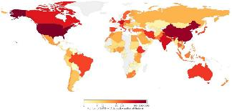


World’s most used Hydrological model
Industry-standard model
Applications in 130+ countries
Turns river flows into clear flood outputs:
  water levels
  flood depth
  inundation maps
> 40 years in application
1D/2D flood mapping

Slide 8
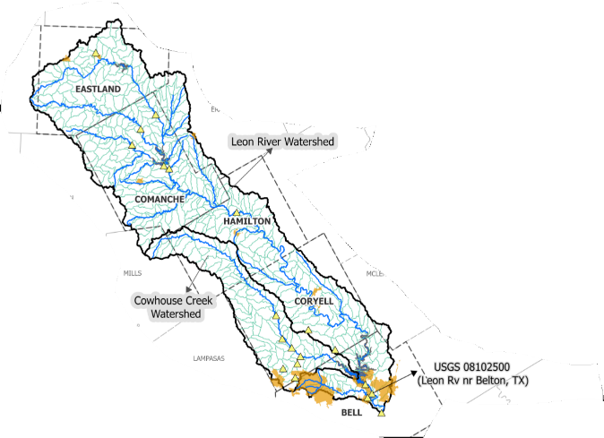
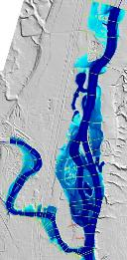
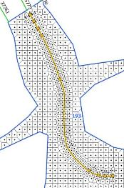
SWAT (Hydrology)
  HUC14 scale watersheds
  ~20 sq km (~8 sq miles)
  448 HUC14 watersheds
    HECRAS (Flood/Inundation)
      ~6,000 culverts
      1D and 2D modeling

Slide 9
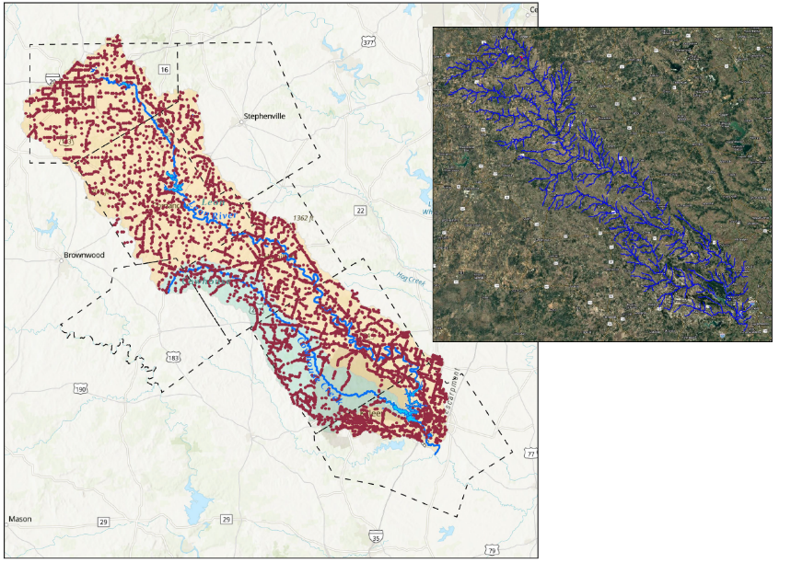

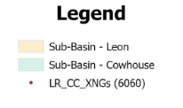
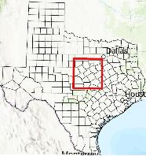
Leon River & Cowhouse Creek Water Crossings
Culvert
Overview Map
on
NRS
\ I\Annt
Natural Resources Solutions.Le

Slide 10




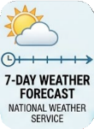

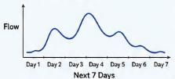
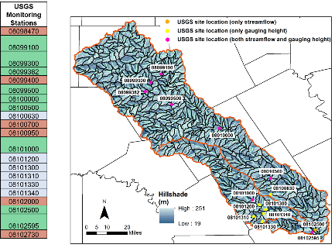
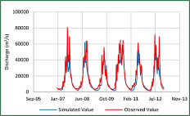
Weather information (Hourly)
Historical- NOAA MRMS Data (2014-2025)
Forecasts- National Weather Services
Federally approved datasets
Landcover- USDA-NASS Cropland Data Layer
Soils- USDA-NRCS SSURGO/STATSGO
Topography- SRTM DEM
Stream networks- EPA NHDplus 2.0

Slide 11



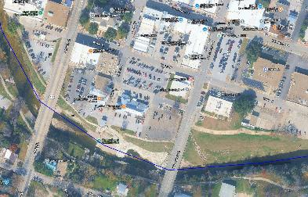
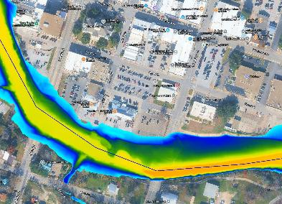



HECRAS (Flood/Inundation)
LiDAR 1m
~6,000 culverts
1D and 2D modeling
National Weather Services Weather Forecast Offices
2.5 km x 2.5 km
Hourly forecast for next 7 days
Predictions – each hour

Slide 12
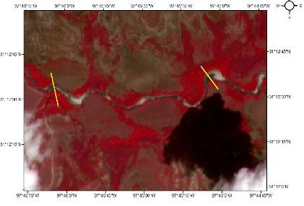
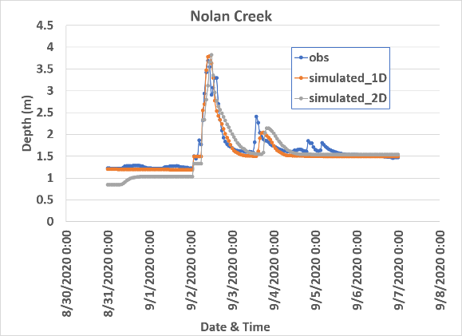
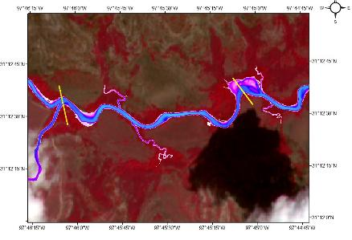
Satellite 60 m and 90 m
Validation
USGS gauge heights
Satellite
Cowhouse Creek
Model- 64 m and 87 m

Slide 13
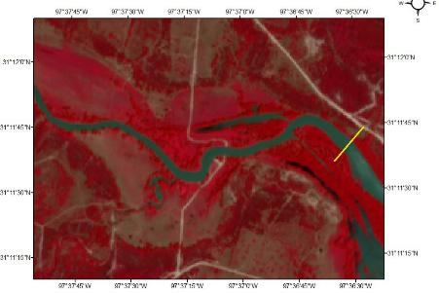
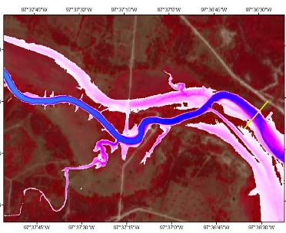
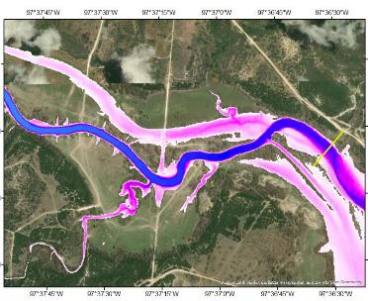
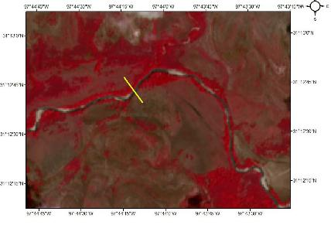
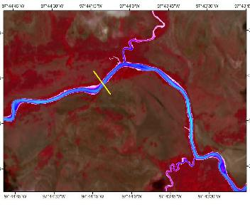
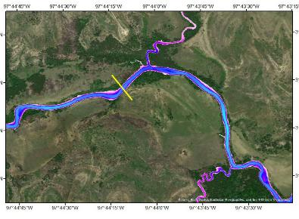
Satellite- 110 m
Model- 115 m
Satellite- 50 m
Model- 54 m

Slide 14
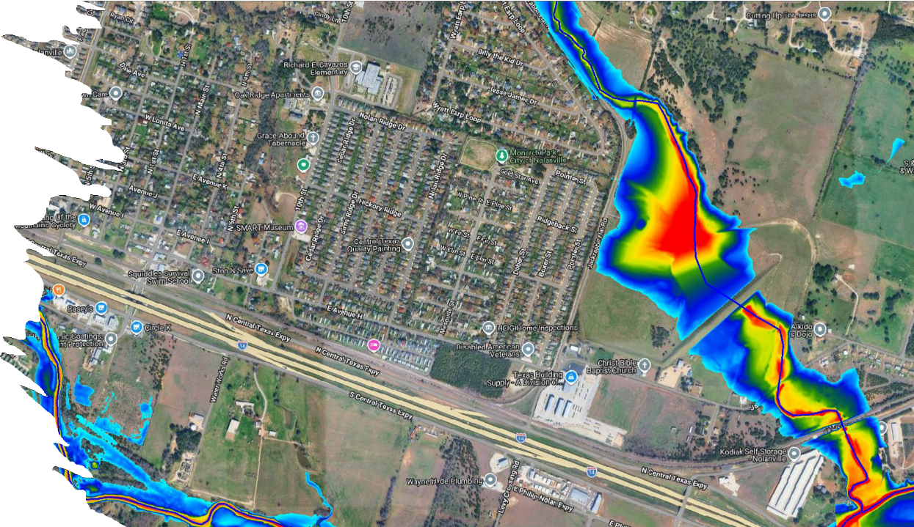

Slide 15

Reducing & Understanding Flood Risk & Understanding Future Water Supplies in Leon River and Cow Creek Watersheds
Prepared for Texas A&M Agrilife Research Funded by Texas General Land Office
Stakeholder Meeting II, Blackland Research & Extension Center,
May 28, 2026
1

Slide 16
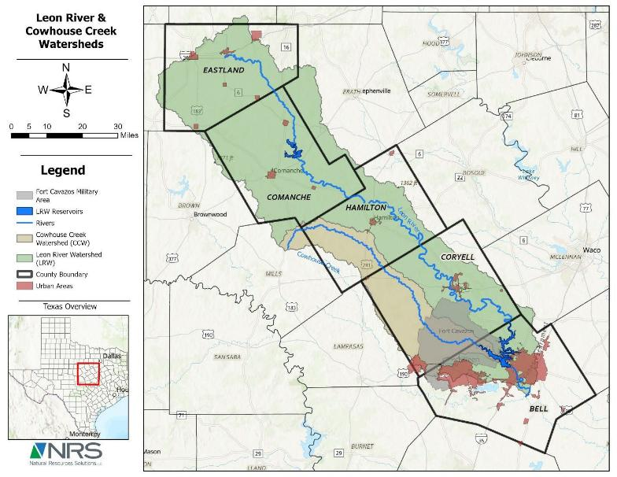

Project Objectives: GW-SW linked simulation
Linked GW-SW models
County-level growth & water supply planning
Managed Aquifer Recharge Applications

Slide 17
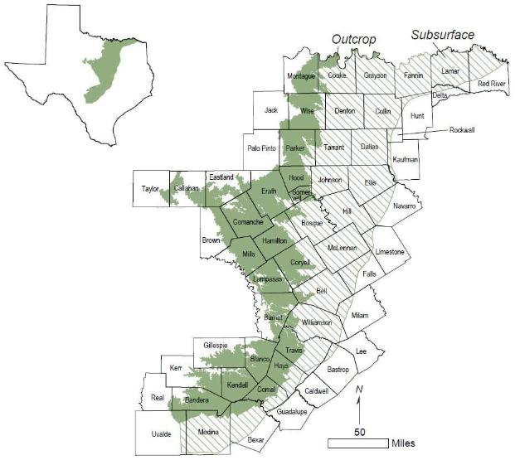
Groundwater Modeling: GMA 8 Trinity GAM
Final GAM released (March 2026) & used
Layer 1: Younger
Layer 2: Woodbine
Layer 3: Washita/Fred.
Layer 4: Paluxy
Layer 5: Glen Rose
Layer 6: Hensall
Layer 7: Pearsall
Layer 8: Hosston

Slide 18
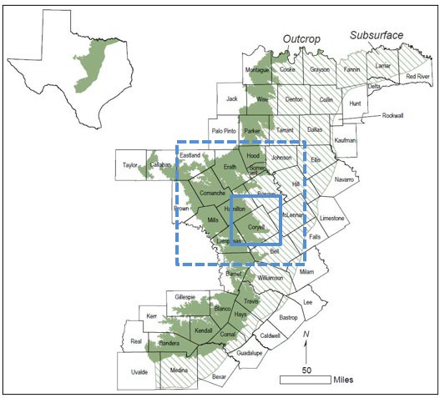
Groundwater Modeling: Key Components
Grid in AOI
Pumping in AOI
Recharge in AOI
Calibration check

Slide 19
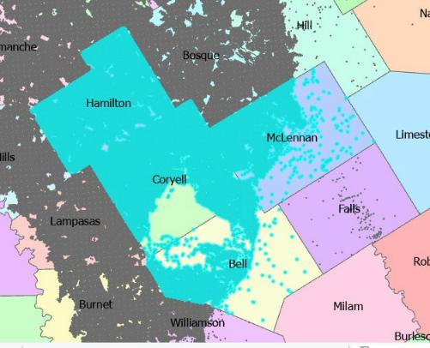




Pumping Split in Parts of AOI
2020 pumping split
Pumping in AFY
16000
14000
12000
10000
8000
6000
4000
2000
0
Bell
Coryell
Hamilton
McLennan

Slide 20
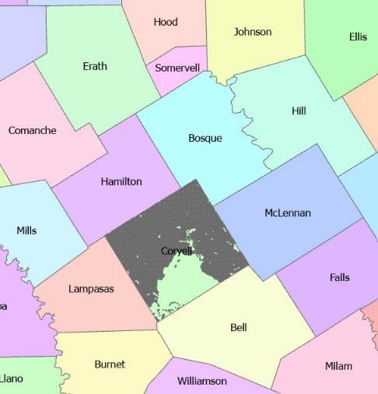



Coryell Pumping (2020)
2020 pumping split between layers
Coryell County Pumping in AFY
1400
1200
1000
800
600
400
200
0

Slide 21
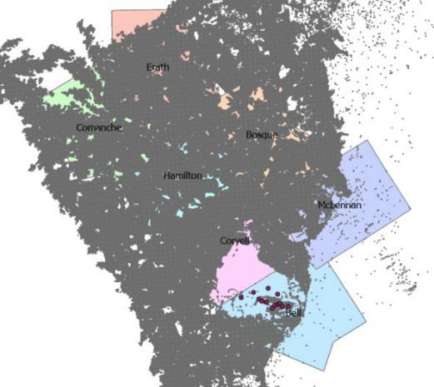
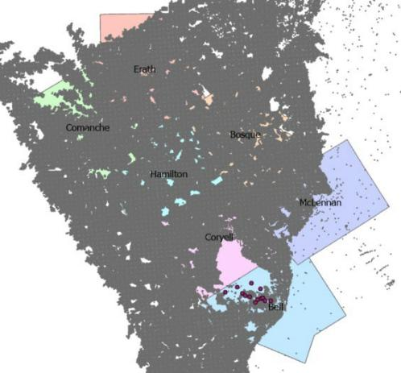
Pumping Coverage (1980-2020)
1980
2020

Slide 22
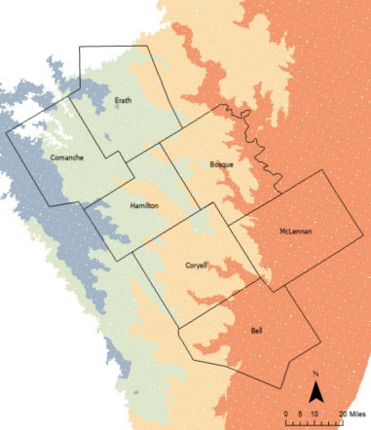
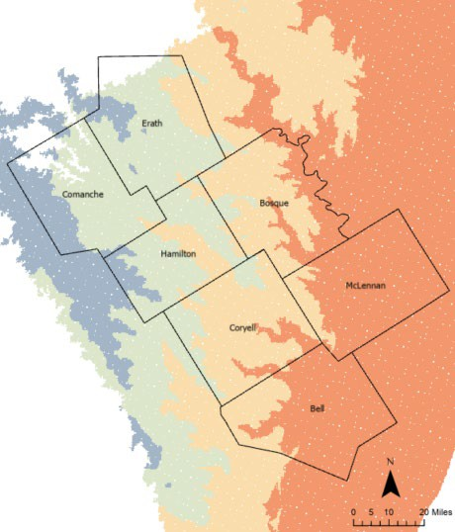
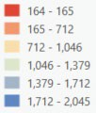
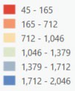
Water Levels: Layer 1 (Younger Formations)
1980
2020

Slide 23
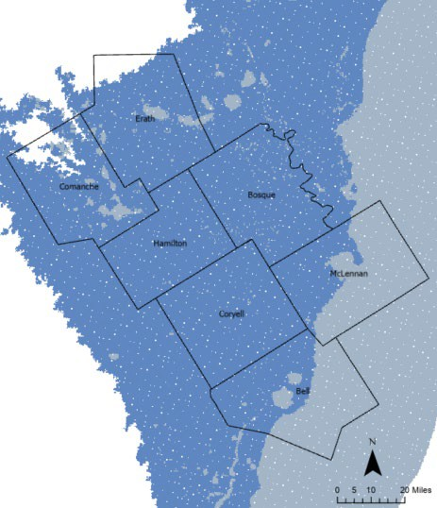
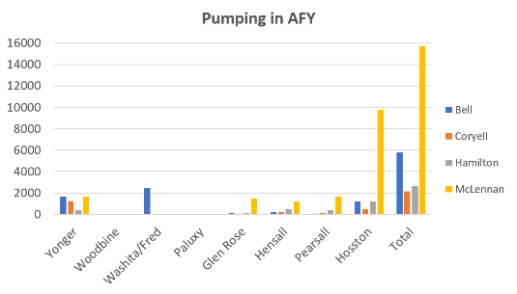

Drawdown/Recovery: Layer 1 (Younger) [1980-2020]
WL 1980 | WL 2020 | Residual (1980 -2020) | Meaning
-400 ft | -200 ft | -200 ft | Strong Recovery
50 ft | 100 ft | -50 ft | Recovery
100 ft | 50 ft | +50 ft | Drawdown
-200 ft | -400 ft | +200 ft | Strong Drawdown
1980 - 2020

Slide 24
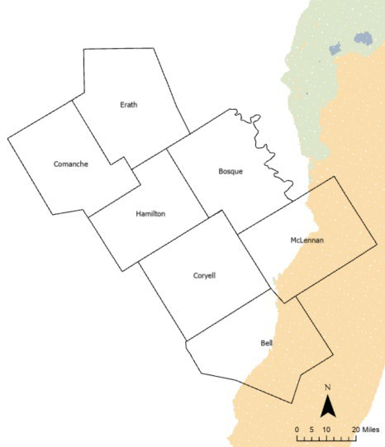

Drawdown/Recovery: Layer 2 (Woodbine) [1980-2020]
WL 1980 | WL 2020 | Residual (1980 -2020) | Meaning
-400 ft | -200 ft | -200 ft | Strong Recovery
50 ft | 100 ft | -50 ft | Recovery
100 ft | 50 ft | +50 ft | Drawdown
-200 ft | -400 ft | +200 ft | Strong Drawdown
1980 - 2020

Slide 25




Water Levels: Layer 3 (Washita/Fredericksburg)
1980
2020

Slide 26


Drawdown/Recovery: Layer 3 (1980-2020)
WL 1980 | WL 2020 | Residual (1980 -2020) | Meaning
-400 ft | -200 ft | -200 ft | Strong Recovery
50 ft | 100 ft | -50 ft | Recovery
100 ft | 50 ft | +50 ft | Drawdown
-200 ft | -400 ft | +200 ft | Strong Drawdown
1980 - 2020

Slide 27


Drawdown/Recovery: Layer 4 (Paluxy) [1980-2020]
WL 1980 | WL 2020 | Residual (1980 -2020) | Meaning
-400 ft | -200 ft | -200 ft | Strong Recovery
50 ft | 100 ft | -50 ft | Recovery
100 ft | 50 ft | +50 ft | Drawdown
-200 ft | -400 ft | +200 ft | Strong Drawdown
1980 - 2020

Slide 28




Water Levels: Layer 5 (Glen Rose)
1980
2020

Slide 29


Drawdown/Recovery: Layer 5 (Glen Rose) [1980-2020]
WL 1980 | WL 2020 | Residual (1980 -2020) | Meaning
-400 ft | -200 ft | -200 ft | Strong Recovery
50 ft | 100 ft | -50 ft | Recovery
100 ft | 50 ft | +50 ft | Drawdown
-200 ft | -400 ft | +200 ft | Strong Drawdown
1980 - 2020

Slide 30




Water Levels: Layer 6 (Hensall)
1980
2020

Slide 31


Drawdown/Recovery: Layer 6 (Hensall) [1980-2020]
WL 1980 | WL 2020 | Residual (1980 -2020) | Meaning
-400 ft | -200 ft | -200 ft | Strong Recovery
50 ft | 100 ft | -50 ft | Recovery
100 ft | 50 ft | +50 ft | Drawdown
-200 ft | -400 ft | +200 ft | Strong Drawdown
1980 - 2020

Slide 32




Water Levels: Layer 7 (Pearsall)
1980
2020

Slide 33


Drawdown/Recovery: Layer 7(Pearsall) [1980-2020]
WL 1980 | WL 2020 | Residual (1980 -2020) | Meaning
-400 ft | -200 ft | -200 ft | Strong Recovery
50 ft | 100 ft | -50 ft | Recovery
100 ft | 50 ft | +50 ft | Drawdown
-200 ft | -400 ft | +200 ft | Strong Drawdown
1980 - 2020

Slide 34




Water Levels: Layer 8 (Hosston)
1980
2020

Slide 35


Drawdown/Recovery: Layer 8 (Hosston) [1980-2020]
WL 1980 | WL 2020 | Residual (1980 -2020) | Meaning
-400 ft | -200 ft | -200 ft | Strong Recovery
50 ft | 100 ft | -50 ft | Recovery
100 ft | 50 ft | +50 ft | Drawdown
-200 ft | -400 ft | +200 ft | Strong Drawdown
1980 - 2020

Slide 36


Future Direction
Scenario Analysis
  Pumping to 2080 – DFC
  Recharge to 2080 – SWAT
    LAYER 1 Sensitive to Recharge
Identify MAR locations
  Historical & Future WLs
  Flood Zones Overlap
  Recharge-rich Zones
Future Pumping Impacts to Water Supply

Slide 37

Optional: Explore Transmissivity Values in AOI

Slide 38
Contact Information
Rohit R. Goswami, Ph.D., P.E. _{(TX)}
rohit@rrgpe.com 561.613.3627

Slide 39




FLOOD MANAGEMENT PLAN UPDATES
1

Slide 40




Flood Mitigation Program
4.1 COMMUNITY ASSESSMENT
    Assemble Stakeholder groups for LRW, CCW and downstream communities
    Conduct public outreach
4.1.3 Document the community assessment
4.2 WATERSHED ASSESSMENT
    Historical
    Demographic
    Topographic
    Watershed Assessment Summary
4.3
FLOOD MITIGATION
PROGRAM
    Determine Local Flood Risk Needs
    Formal Flood Mitigation Plan
    Low-Cost Stream Sensors and Road Signage Placement
    Flood and High-Water Safety Education
    Flood Mitigation Final Report

Slide 41


Flood Mitigation Plan
Ties all assessments together
Creates a clear picture of flood risk.
Improves Emergency Response
Helps emergency responders act faster and more effectively.
Provides a way to communicate real-time threats
Keeps communities informed when most important
Inform vulnerable locations
Focus resources where they are needed most

Slide 42

Low-Cost Stream Sensors
Flood Information Page

Slide 43






Stream Guage Field Pictures
N. Bee House Creek & Slater Road - Coryell
Plum Creek & CR 410 - Hamilton
S. Leon River & CR 250 - Comanche

Slide 44





Data Delivery - Current
Dashboard

Slide 45


Data Delivery - Upcoming

Slide 46



THANK YOU
QUESTIONS?

Slide 47


Reducing Flood Risk and Damage in
Central Texas
Leon River and Cowhouse Creek Watersheds
Community Engagement to Improve Flooding and Related Water Issues Updates

Slide 48


Stakeholder Interviews
Who We Interviewed
City and County leaders
Emergency Response Coordinators
Educators
Utility operators
Business and industry leaders
Civic and community representatives

Slide 49
What We Heard About State and Local
Government
Local officials, both elected and agency staffers, are clearly well-informed about their communities' flood vulnerabilities and infrastructure needs.
All local leaders work diligently with limited resources.
Engagement efforts are needed to improve cross unit and jurisdictional planning for flood prevention and response, but staff and funding constraints limit these efforts.
Small counties are affected most by limited staff, funding and aging infrastructure.
More predictable fiscal assistance from the state is greatly needed and should be encouraged. This money is needed to purchase, deploy, manage, monitor and maintain needed warning systems and to improve key infrastructure elements.

Slide 50
What We Heard About Federal Agencies
There are delayed and complicated funding processes, large administrative burdens and reimbursement challenges, especially with FEMA.
FEMA and other funding agency policies often require post-flood repair, not mitigation upgrades.
The fragmented governance and insufficient inter-jurisdictional coordination across federal agencies complicates funding channels and requirements.
Limited technology integration and staffing turnover at federal agencies necessitates duplicative work.

Slide 51





Recommended State Actions
Provide more consistent State funds for flood efforts
Simplify access to funds for rural and small communities
Include maintenance and operation funding
Incentivize cross-jurisdictional cooperation and strategic partnerships
Promote public engagement, education and outreach
Leverage technology and data science for flood prediction and management

Slide 52
Your Thoughts and Ideas – Brainstorm
If your organization received additional money from a State grant to cover costs to plan, implement and maintain just one flood-related project, what project would you choose? Why? How many people here would choose a similar project?
Who would pick something else? Why?
If your organization were able to choose any single policy change to be made by the State, what change would that be? Which agency would you like to be responsible? Why? How many people here agree?
Who would pick something else? Why?
Share follow-up questions or ideas with clgoldsmith@tamu.edu

Slide 53

TAMU ISTPP

